Slide 1

“We teach how your child learns”
Curriculum Offer
2020/2021
Notes:
Start phone timer / refer to clock 15 minute countdown

Slide 2
Curriculum
1 | Rationale
2 | Pathway for Secondary
3 | Pathway for Sixth form
4 | Timetable

Slide 3
1 | Rationale and overview
Rationale
We wanted to change the subjects we offer to meet the needs of our students in school at this time. We needed to make sure that what we offer meets our School mission and helps give you the necessary skills and qualifications to become happy and confident independent people and give you the best chance to move on to further education or employment when the time is right.

Slide 4
1 | Rationale and overview
Our Values
We believe it is important for you to achieve your full potential and progress to a future of your choice. To ensure this, we have put together a varied curriculum, individually tailored to your needs, supported by strong pastoral care, social and emotional support and various therapies.

Slide 5
1 | Rationale and overview
Student Starting points
Blue Skies acknowledges that every learner is different, not only with personal interest, but also their retained knowledge and skills. At Blue Skies, following a transition period, students are assessed and assigned to an appropriate peer group. This will not always be with students that are the same age, but hopefully with those with similar interest and dynamic where possible.

Slide 6
1 | Rationale and overview
Class sizes are limited to a maximum of 7, with many classes around 5 students with two supporting adults (one teacher and one teaching assistant).

Slide 8
2 | Pathway for Secondary

Slide 9
3 | Pathway for Sixth form

Slide 10

4 | Timetable
PDE
What does it stand for?
Personal development and employability
What will I be doing in that time?
This Prince’s Trust qualification has been developed with the aim of progressing learners into further education and/or employment.
You will undertake units pre-planned by your teacher, chosen from this list:
Career planning
Community project
Customer service
Digital skills
Interpersonal and self-management skills
Managing money
Participating in exercise
Personal project
Planning for personal development
Practicing leadership skills
Preparing for a healthy lifestyle
Presentation skills
Teamwork skills
Undertaking an enterprise project
Work experience

Slide 11

4 | Timetable
Target Time
What will I be doing in that time?
Based on your EHCP targets and your Wellbeing Support Plan you will have targets for the term. During target time you will reflect on what has gone well that week, what has not gone so well and how you can improve or get us to help you improve next week. This time will include both independent self-reflection (with some guidance!) and some 1:1 time with your tutor.

Slide 12

4 | Timetable
Haven
What will I be doing in that time?
Haven is a time to help us live more in the here and now. By spending time on art therapies, mindfulness and our own self-reflection we will be able to reduce stress, improve confidence and bring you a happier outlook on life.

Slide 13

4 | Timetable
Chatterbooks / Book Club
What will I be doing in that time?
This is an opportunity to develop your independent reading and share the development of your book with your class.
Staff will be involved and will guide the discussion to support you in making predictions and exploring the themes that arise.

Slide 14

4 | Timetable
Cooking
What will I be doing in that time?
Same as before, you will be cooking each week as a life skill.
This is £2.50 per week to eat / take home.

Slide 15
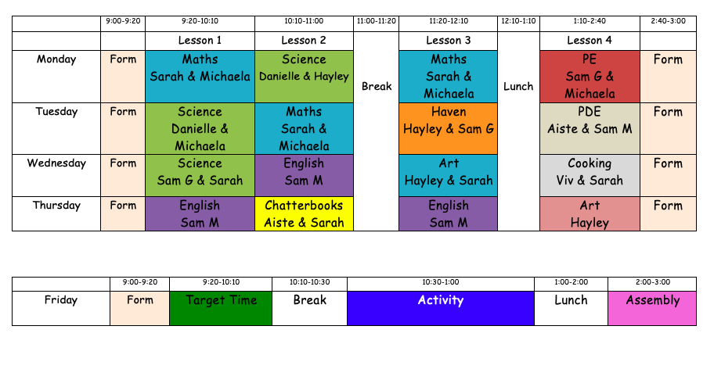

4 | Timetable
Nimbus

Slide 16
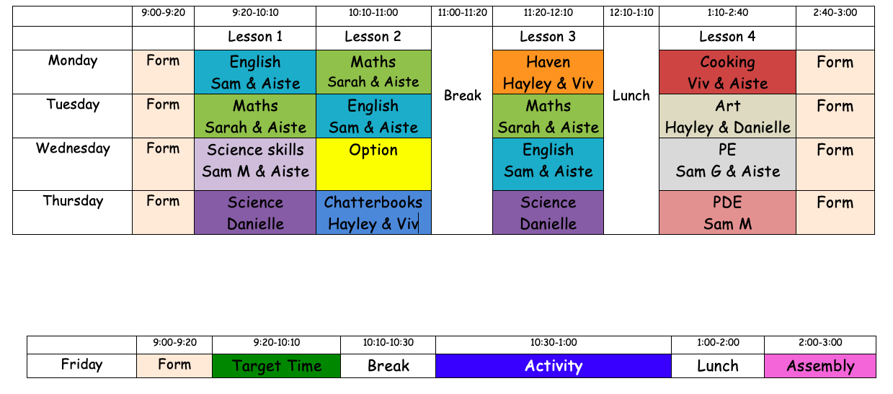
4 | Timetable
Alto

Slide 17
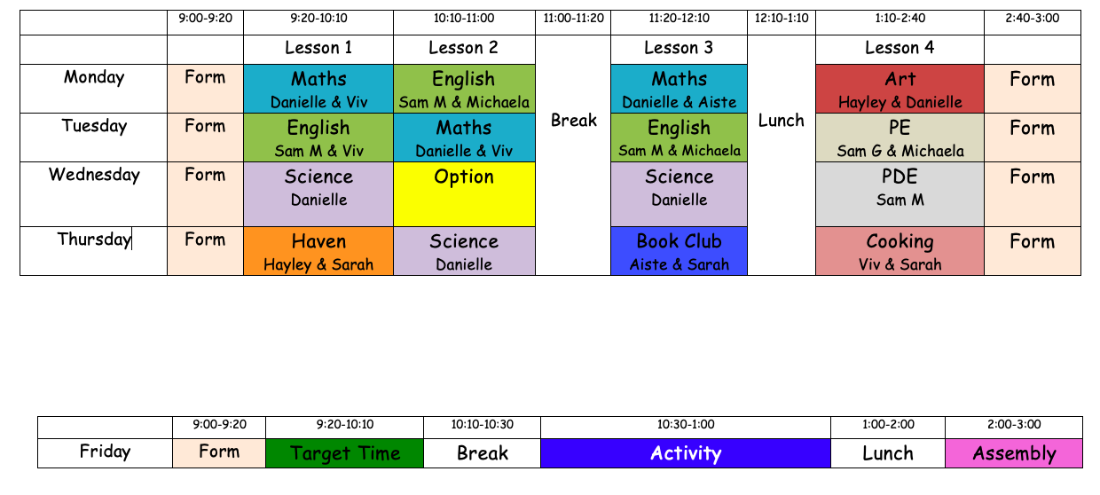
4 | Timetable
Stratus

Slide 18
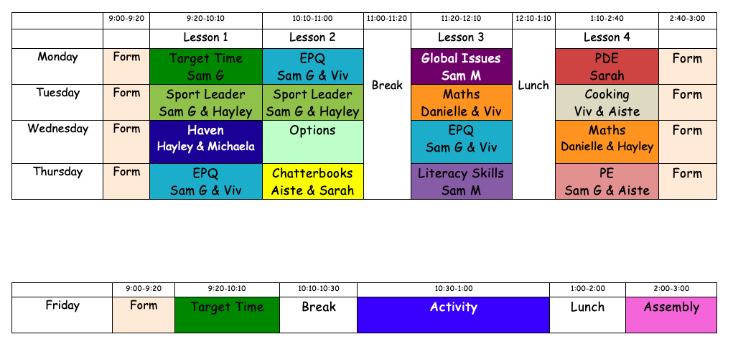
4 | Timetable
Cumulus

